Slide 1
Microsoft Power BI

Slide 2
Power BI Dev Camp – Session 2 Writing PowerShell Scripts for Power BI
Ted Pattison
Principal Program Manager
Customer Advisory Team (CAT) at Microsoft

Slide 3
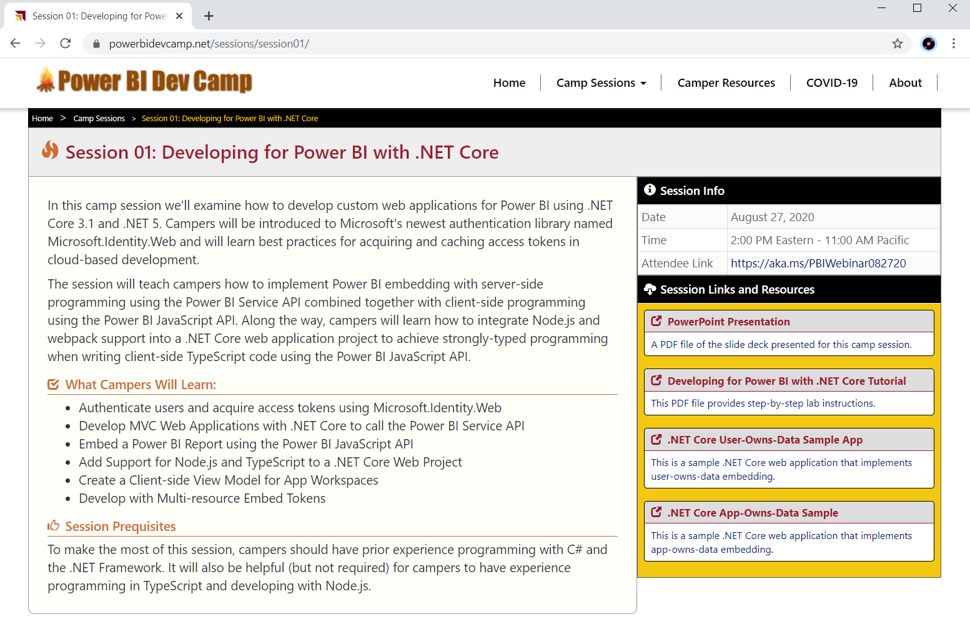
Welcome to Power BI Dev Camp
Power BI Dev Camp Portal - https://powerbidevcamp.net

Slide 4
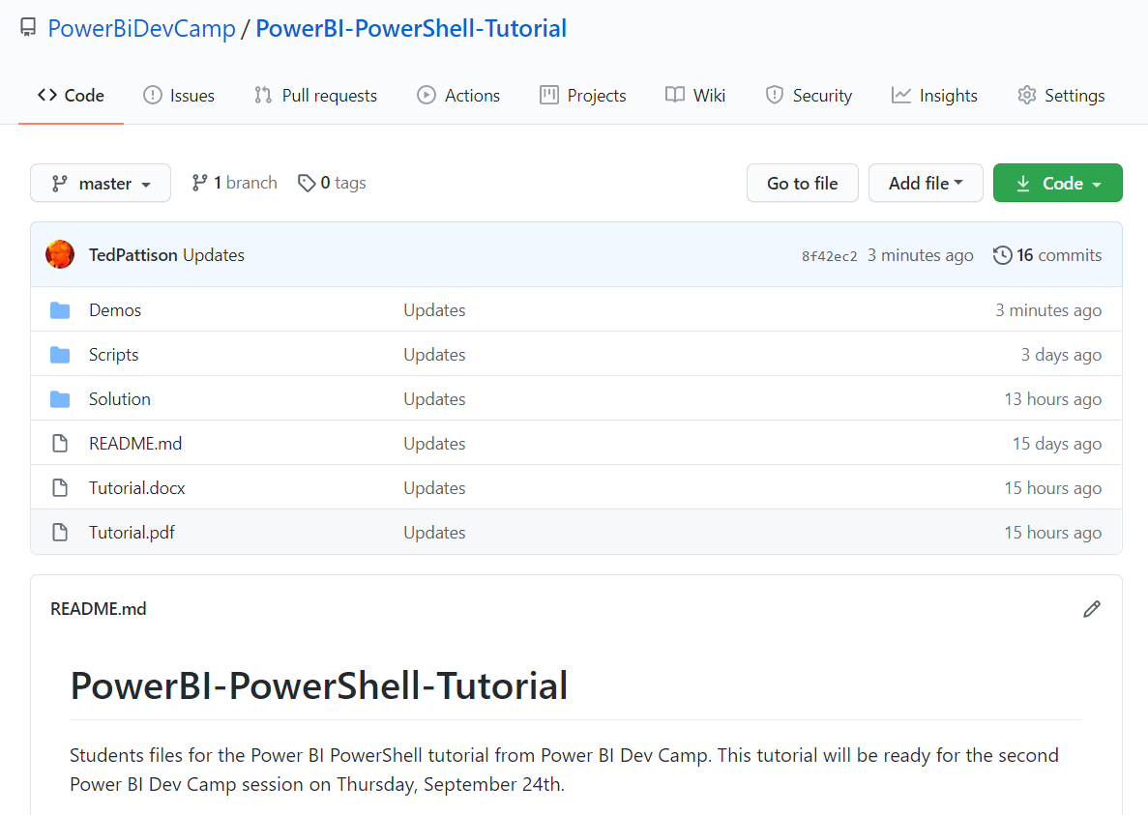
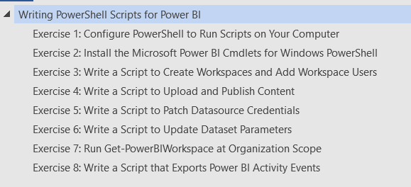
Writing PowerShell Scripts for Power BI Tutorial
https://github.com/PowerBiDevCamp/PowerBI-PowerShell-Tutorial

Slide 5
Agenda
Reviewing of PowerShell Fundamentals
Installing The Power BI Library for PowerShell
Creating and Managing Workspaces
Executing Operations with Invoke-PowerBIRestMethod
Executing Administrative Commands
Running Scripts as Service Principal
Using the DataGateway PowerShell Module

Slide 6
PowerShell Fundamentals
What is PowerShell?
A task automation tool with command shell and scripting language
Function are called cmdlets and follow Verb-Noun naming conventions
Libraries are cmdlets are called modules and can be installed as needed
PowerShell Programming Essentials
Object-based script language
Tab Completion
Pipelining

Slide 7
PowerShell Versions
PowerShell 5 (aka Windows PowerShell)
Comes as part of Windows
Included as part of Windows Management Framework 5
Script authors can use PowerShell Integrated Script Environment (ISE)
PowerShell 7 (aka PowerShell Core)
Introduces cross-platform support for Linux and Mac
Not supported by familiar PowerShell Integrated Script Environment (ISE)
Script authors can use Visual Studio Code with PowerShell Extension

Slide 8
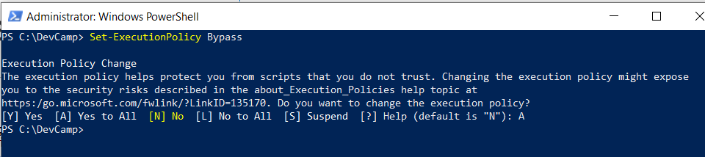
Set-ExecutionPolicy
PowerShell execution policy controls what scripts can run
Default policy does not allow scripts to run if they are not digitally signed
You must call Set-ExecutionPolicy to allow unsigned scripts to execute

Slide 9
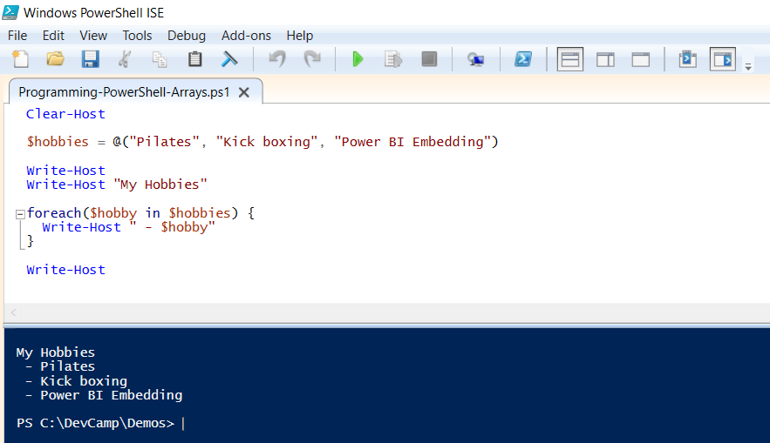
PowerShell Arrays and Enumeration

Slide 10
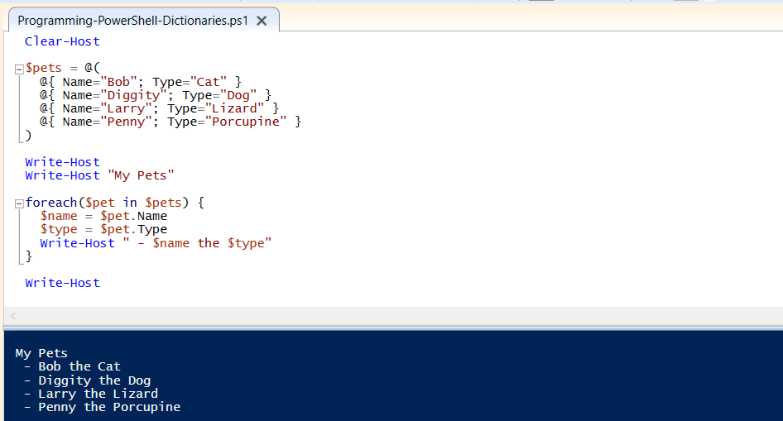
Dictionaries as Objects

Slide 11
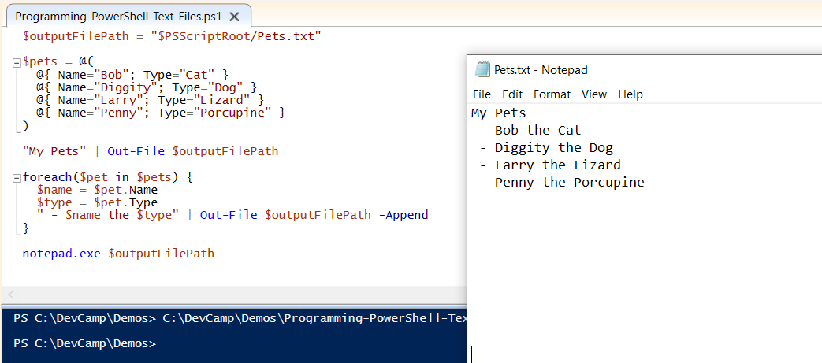
Writing Output to a Text File

Slide 12
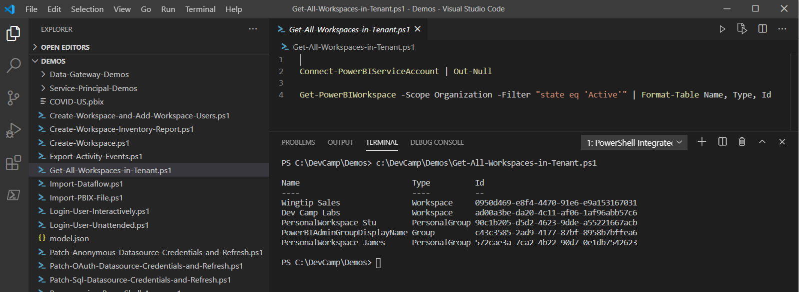
Working with PowerShell 7 and Visual Studio Code
Visual Studio Code provides PowerShell extension
Extension makes it possible to write and test code with PowerShell 7
Great option for developers already familiar with Visual Studio Code

Slide 13
Agenda
Reviewing of PowerShell Fundamentals
Installing The Power BI Library for PowerShell
Creating and Managing Workspaces
Executing Operations with Invoke-PowerBIRestMethod
Executing Administrative Commands
Running Scripts as Service Principal
Using the DataGateway PowerShell Module

Slide 14
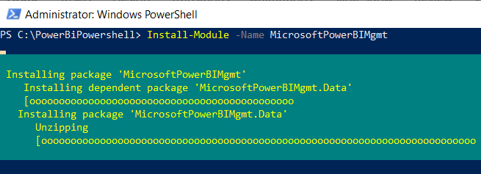
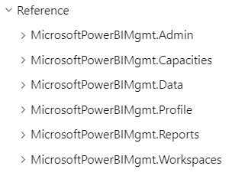
Installing Power BI Cmdlets for PowerShell
Must be installed locally on your computer
https://docs.microsoft.com/en-us/powershell/power-bi/overview
Install-Module -Name MicrosoftPowerBIMgmt

Slide 15
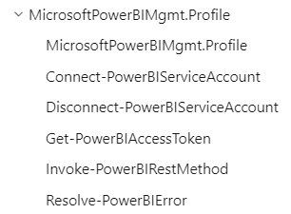
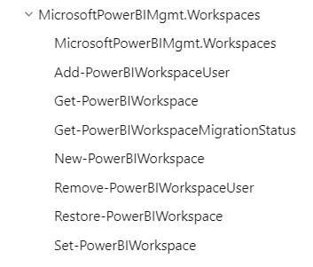
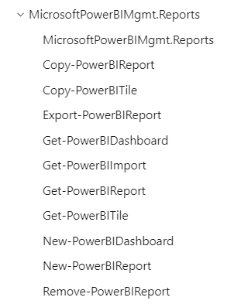
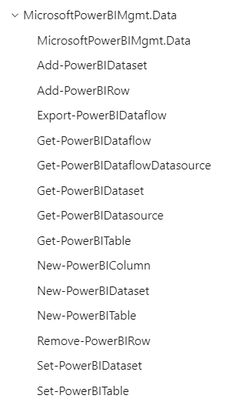
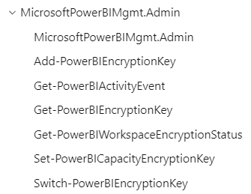

MicrosoftPowerBIMgmt Modules

Slide 16
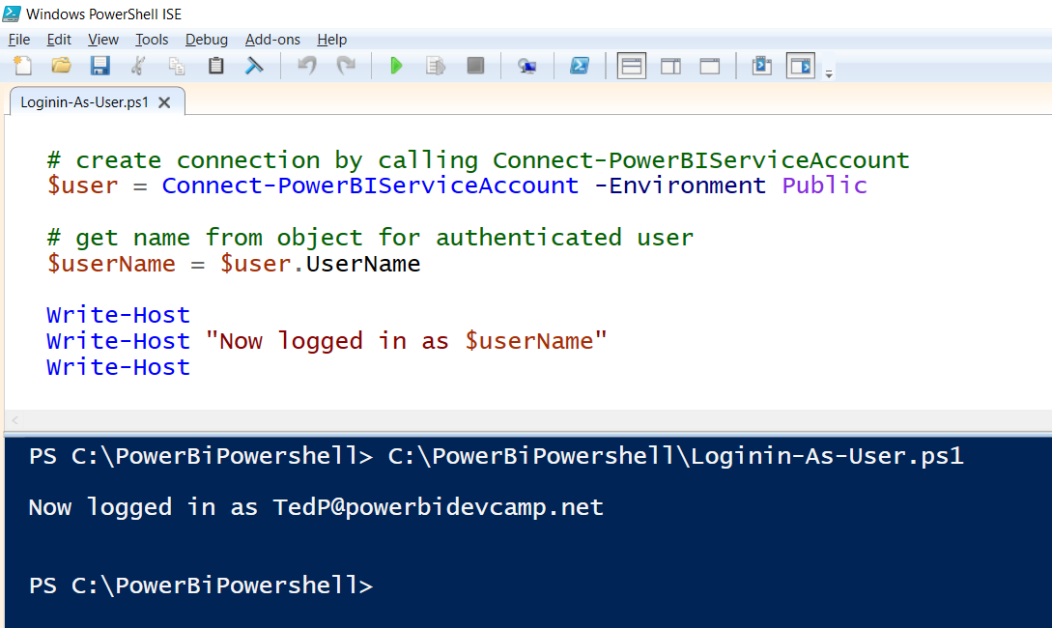
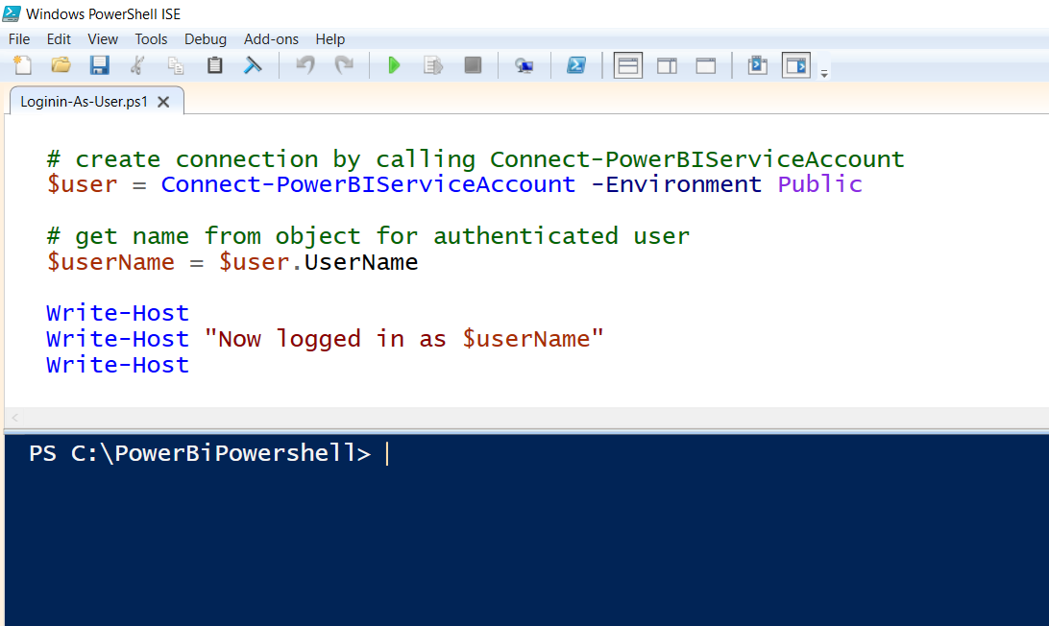
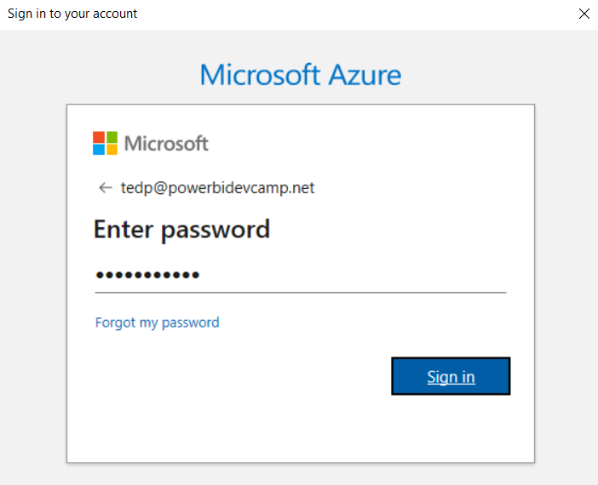
Calling Connect-PowerBiServiceAccount

Slide 17
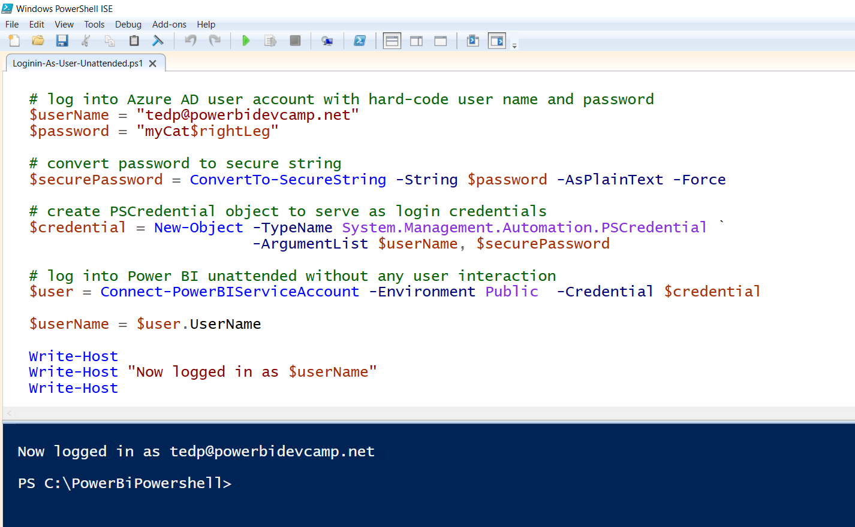
Writing Scripts with Unattended User Login

Slide 18
Agenda
Reviewing of PowerShell Fundamentals
Installing The Power BI Library for PowerShell
Creating and Managing Workspaces
Executing Operations with Invoke-PowerBIRestMethod
Executing Administrative Commands
Running Scripts as Service Principal
Using the DataGateway PowerShell Module

Slide 19
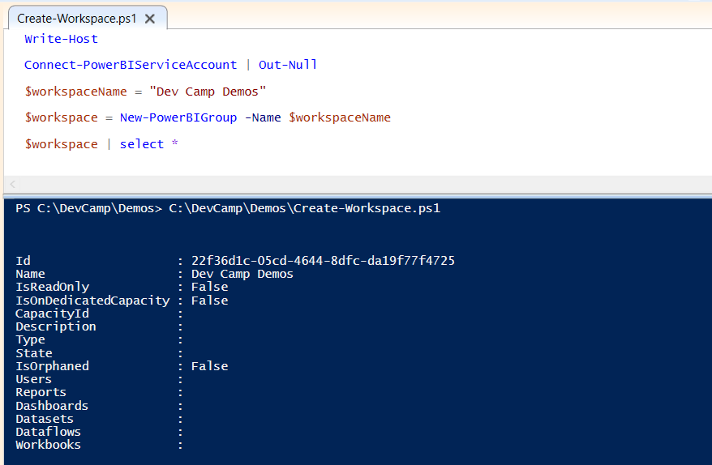
Create Workspace

Slide 20
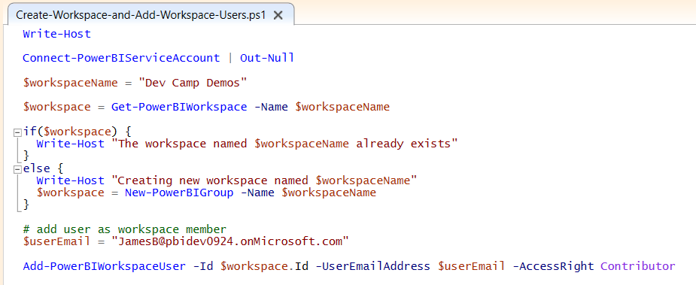
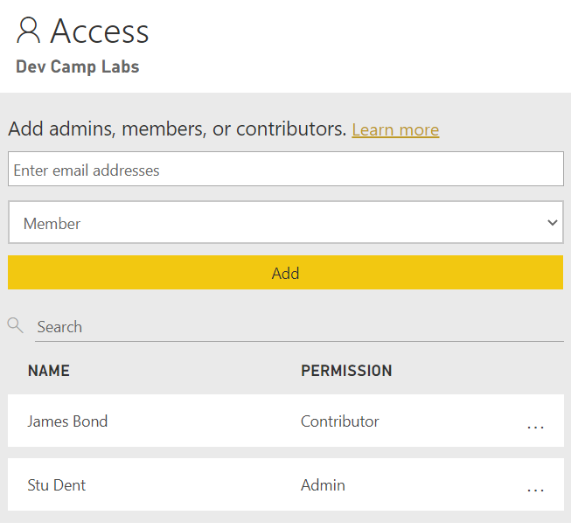
Add Workspace Users

Slide 21
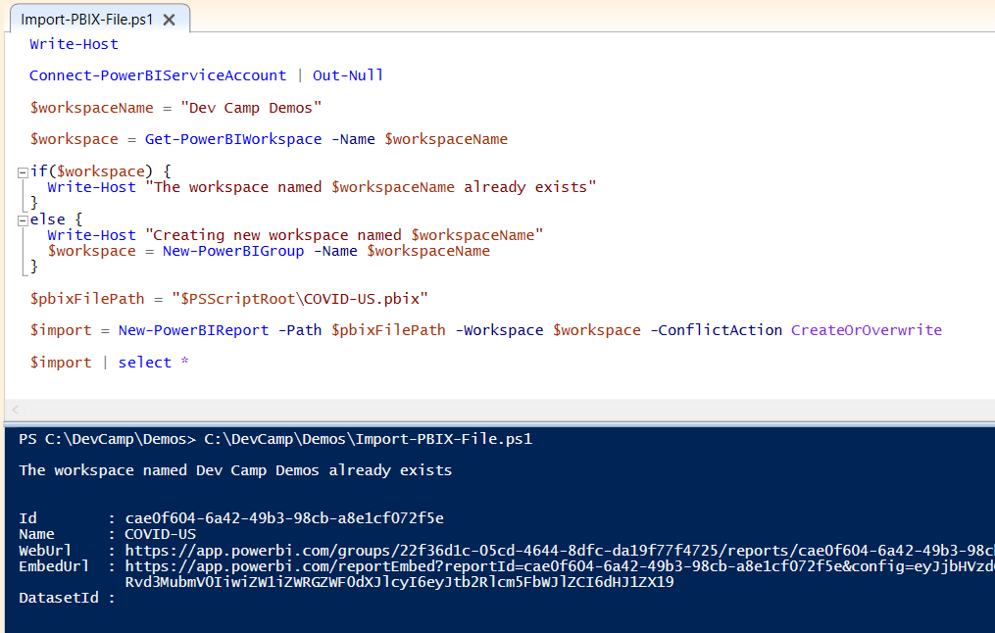
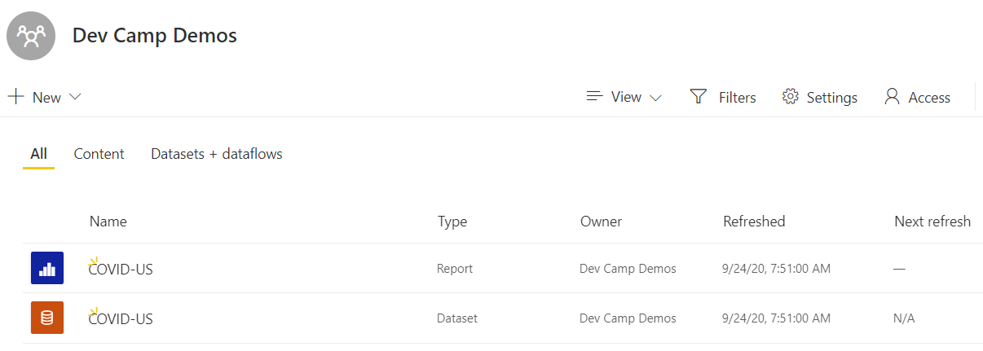
Import PBIX File

Slide 22
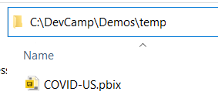
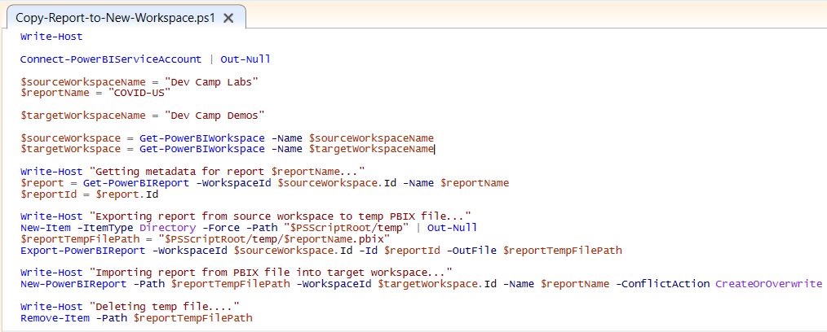
Copy Report to New Workspace
Source
Workspace
Export
Import
Target
Workspace

Slide 23
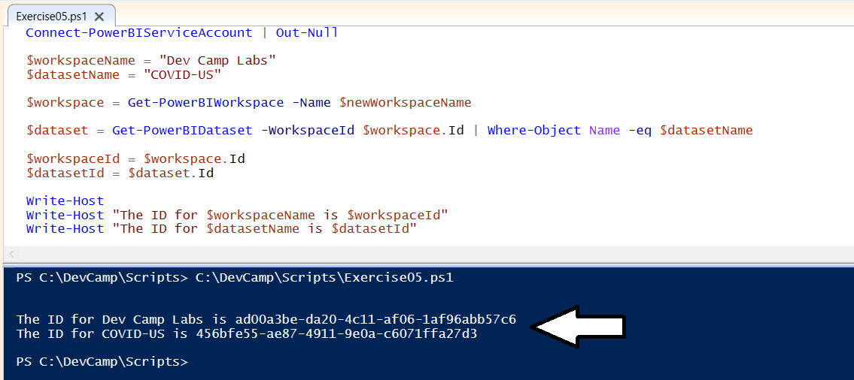
Calling Get-PowerBIDataset

Slide 24
Agenda
Reviewing of PowerShell Fundamentals
Installing The Power BI Library for PowerShell
Creating and Managing Workspaces
Executing Operations with Invoke-PowerBIRestMethod
Executing Administrative Commands
Running Scripts as Service Principal
Using the DataGateway PowerShell Module

Slide 25
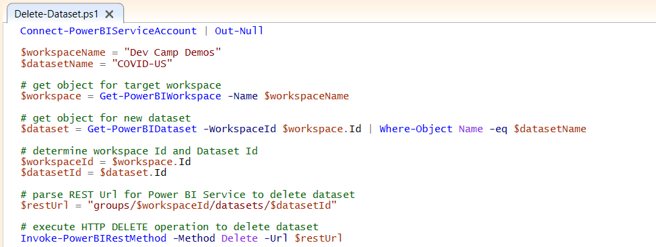
Calling Invoke-PowerBIRestMethod
Many Power BI API operations not exposed directly through cmdlets
Invoke-PowerBIRestMethod makes it possible to call many API operations
Requires that you parse together REST URL for Power BI Service API
Sometimes requires you to construct JSON payload for HTTP request body
Sometimes requires you to parse JSON returned from API call

Slide 26
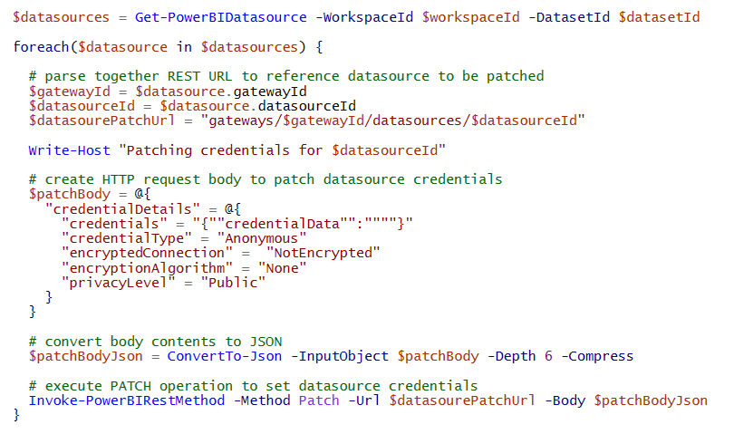
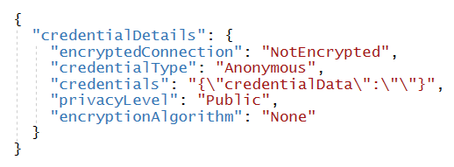
Update Credentials for Anonymous Access
This is what is sent over network

Slide 27
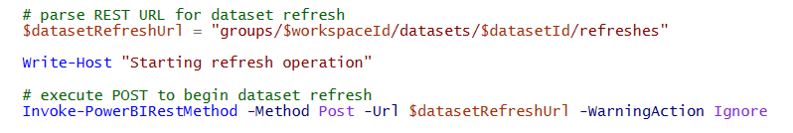
Starting a Refresh Operation

Slide 28
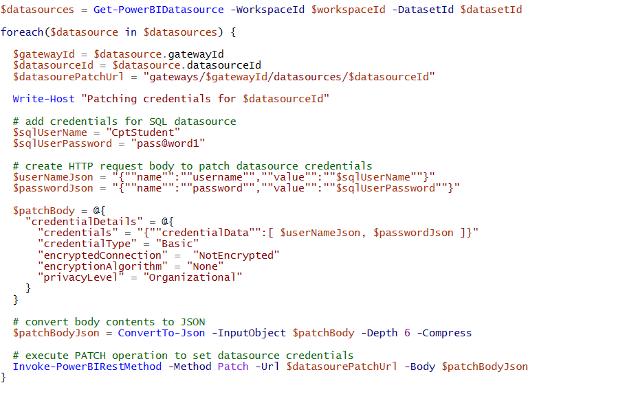
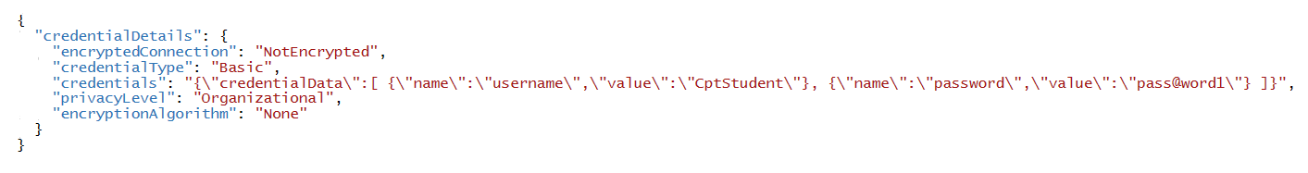
Update Credentials for Azure SQL Server Database
This is what is sent over network

Slide 29
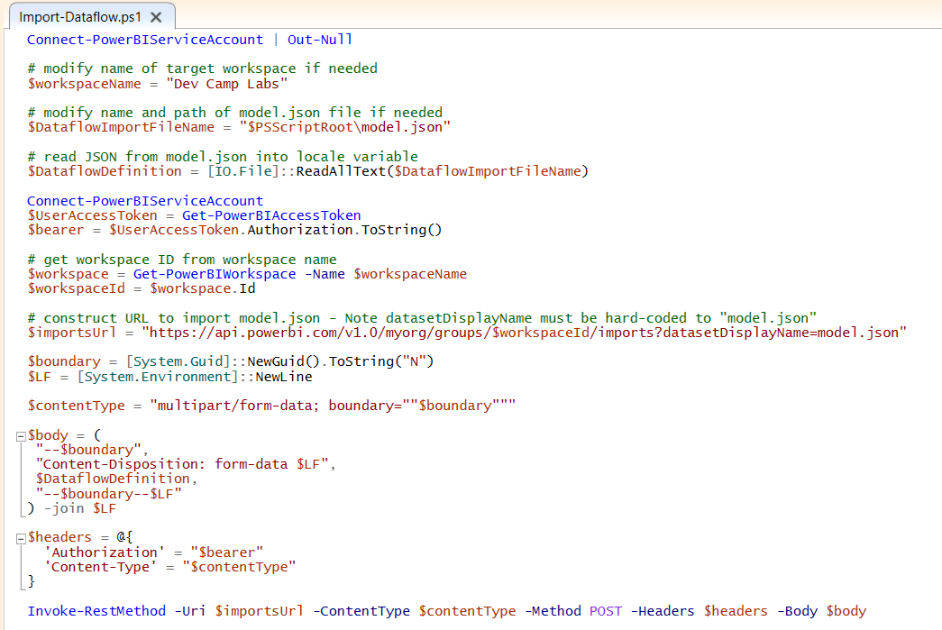
Import Dataflow

Slide 30
Agenda
Reviewing of PowerShell Fundamentals
Installing The Power BI Library for PowerShell
Creating and Managing Workspaces
Executing Operations with Invoke-PowerBIRestMethod
Executing Administrative Commands
Running Scripts as Service Principal
Using the DataGateway PowerShell Module

Slide 31

Individual Scope versus Organizational Scope
Scope can be set to Individual or Organization
Individual scope operates against only workspaces assigned to the caller
Organization scope operates against all workspaces within a tenant
Organization scope makes it possible to discover workspaces resources
Organization scope requires Power BI admin privileges
User must be Power BI Service admin or global tenant admin

Slide 32
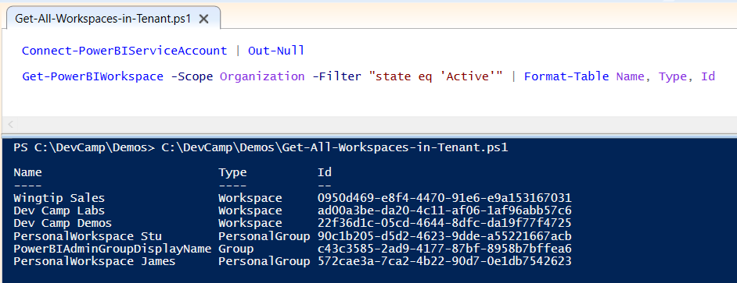
Get All Workspaces in Tenant

Slide 33
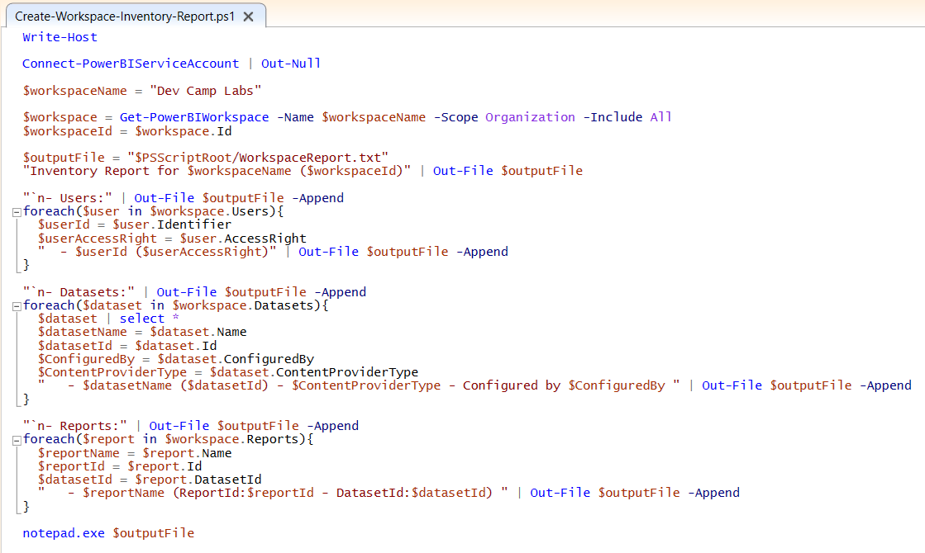
Create Workspace Inventory Report

Slide 34
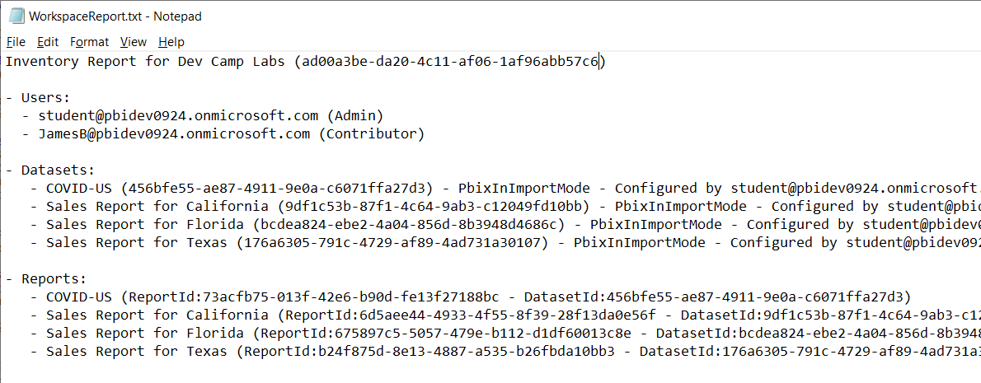
Create Workspace Inventory Report

Slide 35
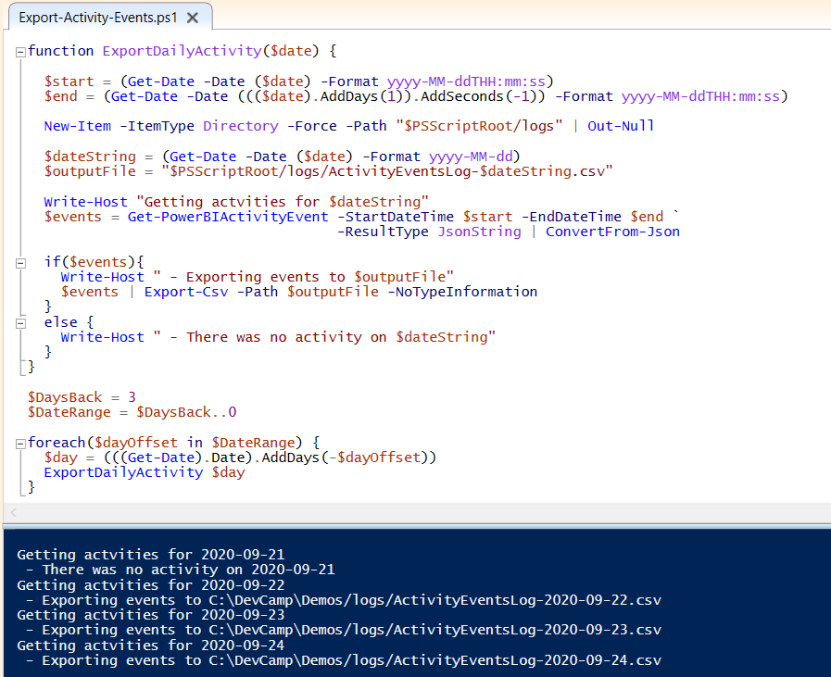
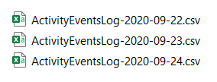
Export Power BI Activity Events

Slide 36
Agenda
Reviewing of PowerShell Fundamentals
Installing The Power BI Library for PowerShell
Creating and Managing Workspaces
Executing Operations with Invoke-PowerBIRestMethod
Executing Administrative Commands
Running Scripts as Service Principal
Using the DataGateway PowerShell Module

Slide 37
Connecting to Power BI using a Service Principal
You can program MicrosoftPowerBIMgmt as Service Principal
Unlike user-based access, this requires creating an Azure AD application
You must also enable tenant-level setting for Service Principal access to API
Service Principal Limitation
Service principal cannot execute Admin API operations
Service principal can only view/access workspaces in which it’s a member

Slide 38
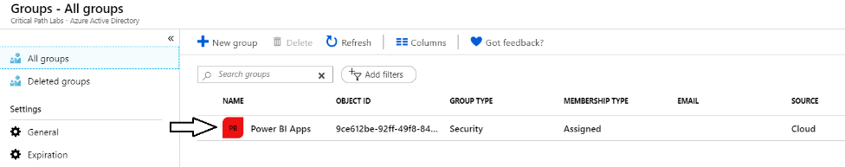
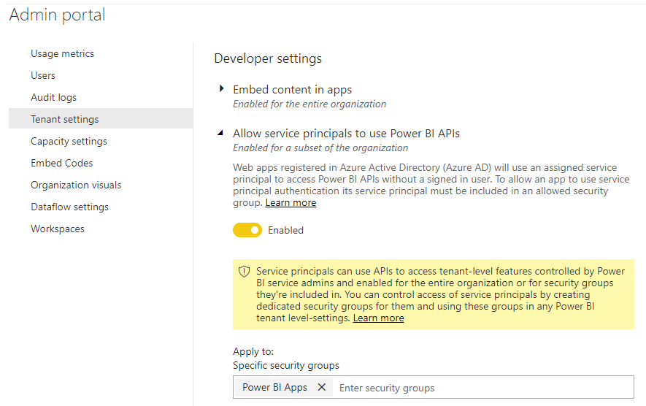
Setting Up for Service Principal Access – Part 1
Enable Service Principal Access to Power BI Service API
Create an Azure AD security group (e.g. Power BI Apps)
Add group to Power BI Allow service principals to use Power BI APIs

Slide 39
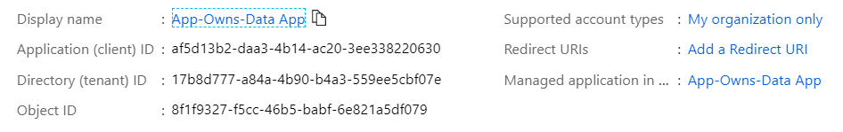
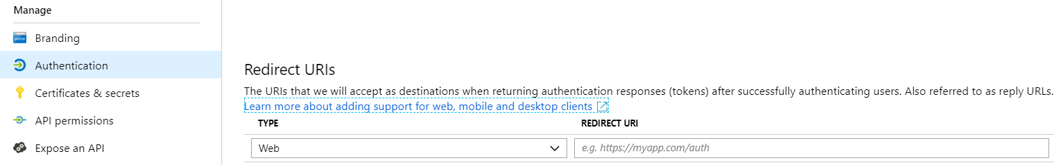
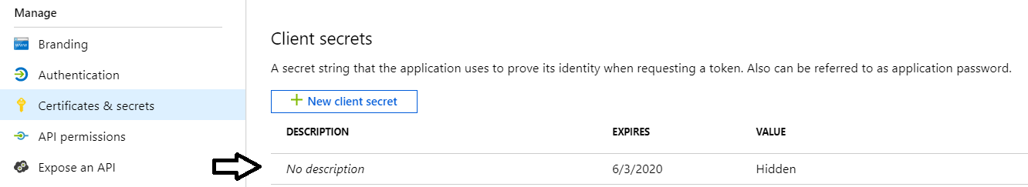
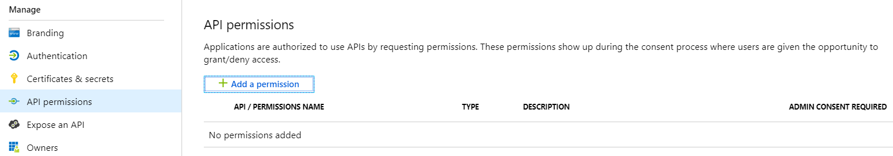
Setting Up for Service Principal Access – Part 2
Create a confidential client in your Azure AD tenant
Configured as TYPE=Web and no need for a redirect URL
Add a client secret or a client certificate
No need to configure any permissions

Slide 40
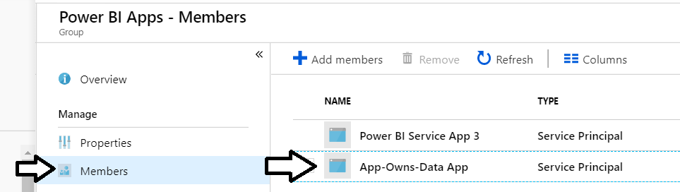
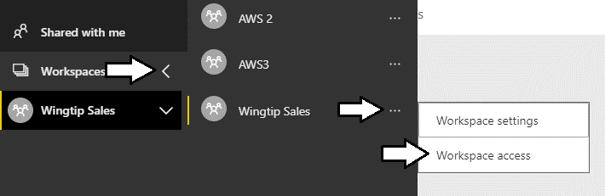
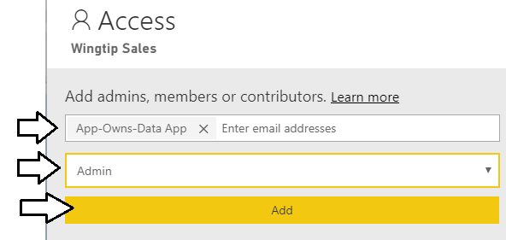
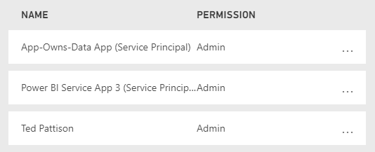
Setting Up for Service Principal Access – Part 3
Add application's service principal in Power BI Apps security group
Configure application's service principal as workspace admin
Service principal should now be workspace admin

Slide 41
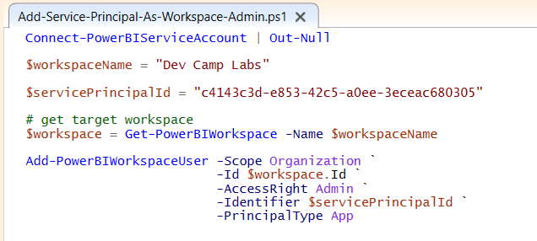
Add Service Principal as Workspace Admin
Make sure to use Service Principal ID and not Application ID

Slide 42

Dataset Takeover by Service Principal

Slide 43
Agenda
Reviewing of PowerShell Fundamentals
Installing The Power BI Library for PowerShell
Creating and Managing Workspaces
Executing Operations with Invoke-PowerBIRestMethod
Executing Administrative Commands
Running Scripts as Service Principal
Using the DataGateway PowerShell Module

Slide 44

PowerShell Cmdlets for On-premises Data Gateway
https://docs.microsoft.com/en-us/powershell/gateway/overview?view=datagateway-ps

Slide 45
Summary
Reviewing of PowerShell Fundamentals
Installing The Power BI Library for PowerShell
Creating and Managing Workspaces
Executing Operations with Invoke-PowerBIRestMethod
Executing Administrative Commands
Running Scripts as Service Principal
Using the DataGateway PowerShell Module

Slide 46
Questions

